Slide 1


Generative AI
Full Stack Developer

Slide 2
Course E :
Optimizing LLM Applications

Slide 3
01 - Advanced Strategies for Cost, Speed, and Scale in the Gemini Ecosystem

Slide 4






Agenda
Optimization Framework
RAG Optimization
Batch vs Real-Time
Lite LLM
Reliability
Caching
Objectives:
Familiarize with the concepts and practices for optimizing Cost, Speed, and Scale in the Gemini Ecosystem

Slide 5



Optimization Framework
Performance
Architecture
Cost & Scale
Model selection, structured prompts, and RAG strategies.
Batch vs. Real-time, Parallel execution, and Streaming.
Context Caching, LiteLLM Proxy, and Observability.

Slide 6
Model Selection Strategy
Gemini 1.5 Flash
Gemini 1.5 Pro
The Workhorse (80% of tasks)
The Expert (20% of tasks)
High throughput & Low latency.
Cost: ~$0.075 / 1M input tokens.
Best For: Summarization, Data Extraction, RAG re-ranking, High-volume chat.
Deep reasoning & Nuance.
Cost: ~$3.50 / 1M input tokens.
Best For: Complex code generation, Creative writing, Mathematical reasoning.

Slide 7
Strict Structured Outputs
Eliminate Parsing Failures
Use response_mime_type: "application/json" to force Gemini to output valid JSON.
Cost Impact
Zero Retries: Invalid JSON often forces a retry loop. Eliminating format errors directly saves 30-50% on token costs for data extraction tasks.
Token Efficiency: Removes "conversational filler" (e.g., "Here is the JSON you asked for..."), saving output tokens.

Slide 8
RAG Optimization: The "Long Context" Shift
Traditional RAG vs. Long Context
Gemini 2.5's 2 Million Token context window changes the game.
Chunking is optional: For datasets < 1M tokens, dump the entire document into context.
Accuracy: "Many-Shot" in-context learning often outperforms retrieval systems by seeing the global context.
Simplicity: Eliminates Vector DB maintenance and retrieval latency.

Slide 9
Architecture: Batch vs. Real-Time
Feature | Real-Time (Online) | Gemini Batch API
Latency | < 2 Seconds (Interactive) | 24 Hours (Asynchronous)
Cost Benefit | Standard Pay-as-you-go | 50% Discount Guaranteed
Throughput | RPM Limited | Massive Parallelism
Ideal Use | Chatbots, Search, Agents | Nightly Evals, Bulk Labeling, Content Migration

Slide 10

Real-Time Speed: TTFT
<200ms
Stream
Target Time-to-First-Token
Always Use Streaming
Perceived Latency Strategy:
Users perceive "speed" based on when the first word appears. Streaming decouples generation time from waiting time.
Combine with Gemini Flash for near-instant responsiveness.

Slide 11
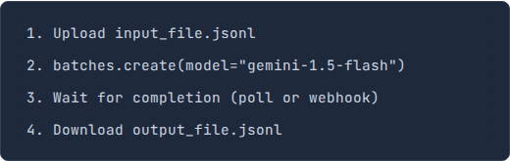
Gemini Batch API
Process More, Pay Half
The Batch API allows you to send large asynchronous job requests (JSONL files). It is designed for workloads that are not time-sensitive.
Workflow

Slide 12
Parallel Execution Pattern
Concurrency is Key
LLMs are I/O bound. Never process requests serially (one after another) in a pipeline.
Implementation
Python: Use asyncio.gather(*tasks).
Result: Process 100 documents in the time it takes to process 1, limited only by your Rate Limit (RPM).

Slide 13
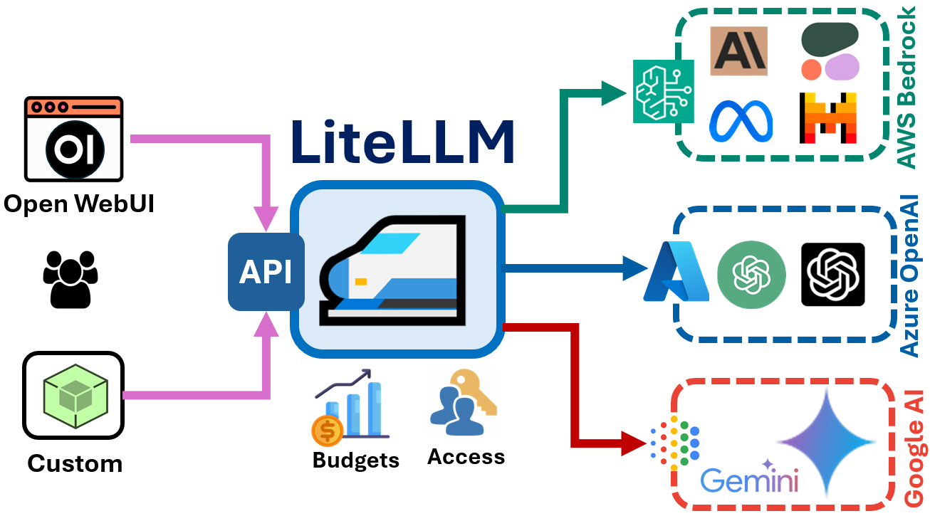
LiteLLM: The Universal Proxy
Decouple Code from Provider
LiteLLM acts as a middleware that standardizes inputs/outputs to the OpenAI format, allowing you to swap Gemini, Claude, or GPT with a single configuration change.
This prevents vendor lock-in and allows for dynamic model routing based on task complexity.

Slide 14
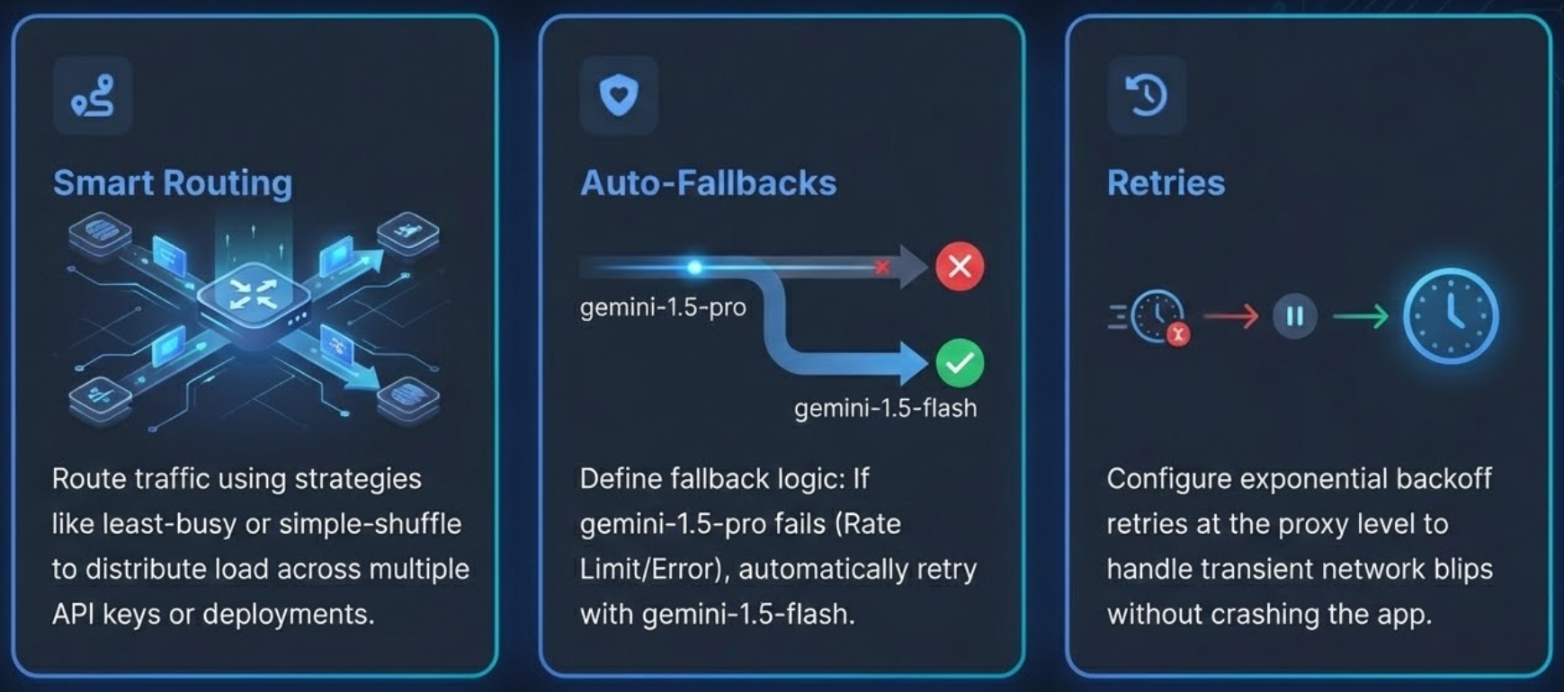
Reliability: Router & Fallbacks

Slide 15
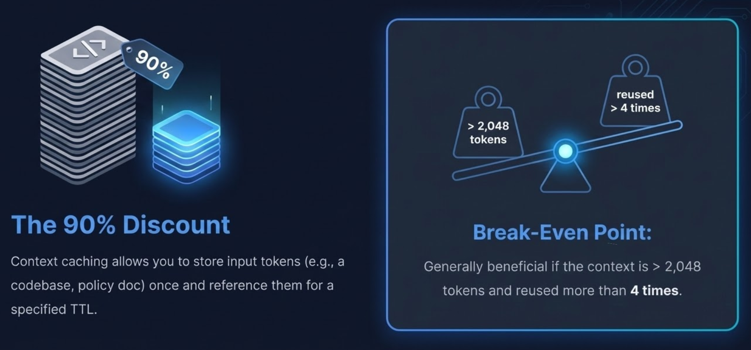
Gemini Context Caching Economics

Slide 16
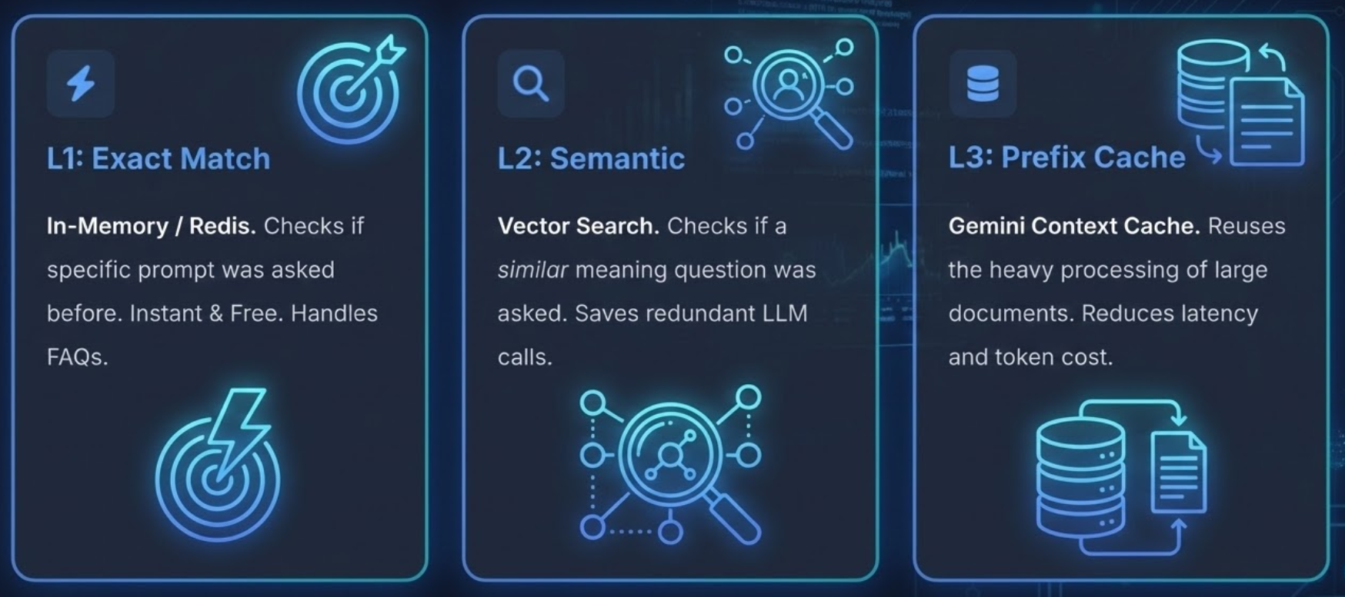
The Caching Ladder

Slide 17




Observability & Cost Tracking
You can’t optimize what you can’t see
Use LiteLLM’s callback system to send usage data to observability tools( LangFuse, Helicone, or Custom DB).
Key Metrics to Track
Spend per User/Tag: Identify who is burning the budget.
Latency (p95/p99): Detect slow responses affecting user experience.
Cache Hit Rate: Verify your optimization strategies are working.

Slide 18
Q/A

Slide 19
Thanks

